Slide 1


Trump’s tweets v. the S&P500
Group 7: Jared Madris, jenny yi, Nathan Mace, Stephanie ROman

Slide 2
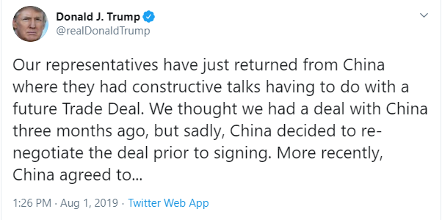
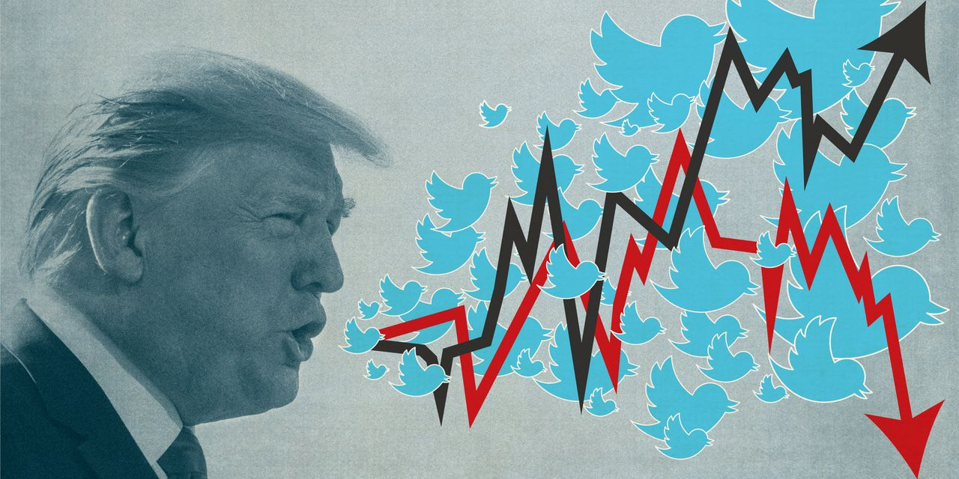
RESEARCH background
CONTEXT
In August 2019, Trump posted a series of tweets starting his plan to 10% tariffs on $300 billion worth of imports from China, in addition to the $250 billion already subject to levies. The S&P 500 fell 0.9% that same day and tumbled almost 3% the following Monday.
QUESTIONS
Do Trump’s tweets really move the markets? Using machine learning, can we build and train a model to determine the relationship between Trump’s tweets vs. S&P 500 movements?

Slide 3

RESEARCH APPROACH
ETL Trump’s Tweet Data
ETL S&P 500 Intraday Data
Add NLP Sentiment Analysis to Trump’s Tweets
Calculate Volatility of S&P 500 Prices
Merge 2 Datasets
Feed it into our Model
See What Correlates
Profit

Slide 4
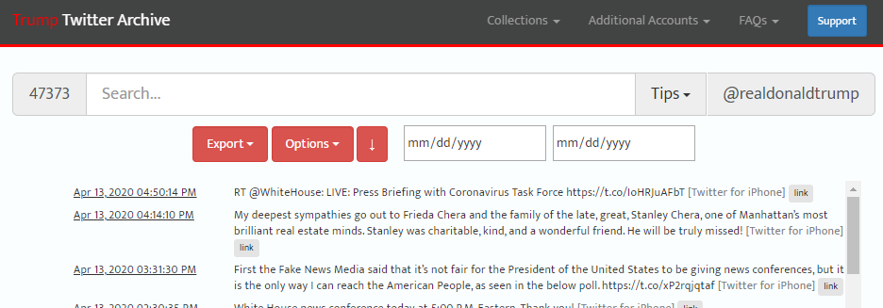
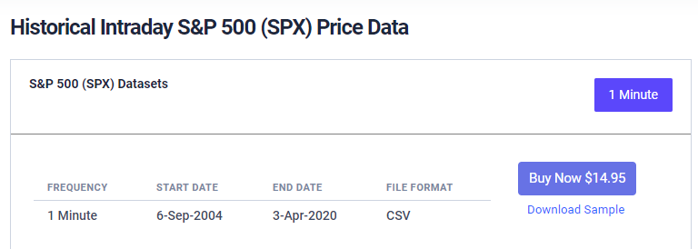
Data sources
1. http://www.trumptwitterarchive.com/archive
2. https://firstratedata.com/i/index/SPX
Notes:
Those >50YO are more likely to dislike rigid fabric and wide leg.

Slide 5
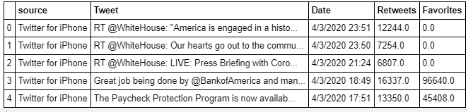
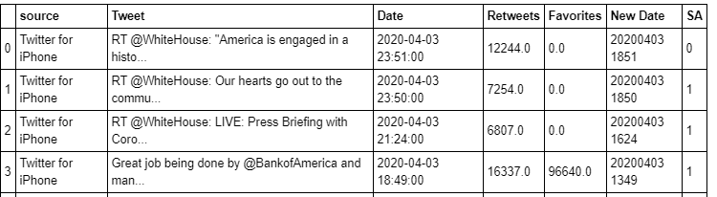

Trump’s Tweets ETL
After extracting Trump’s tweets from 01/20/2017 to 04/13/2020 (his presidency), we added a sentiment analysis (SA) column using Textblob’s def analize_sentiment(): function and we transformed the date column to match our S&P500 date format (New Date).

Slide 6
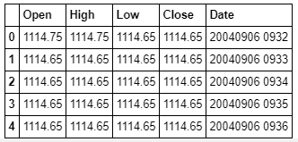
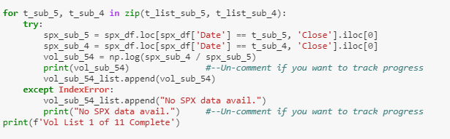
S&P500 Intraday data ETL
After extracting and concatenating S&P 500 Intraday data from 2004 to 2020, we calculated the volatility of the stock leading up to and after the tweet.

Slide 7
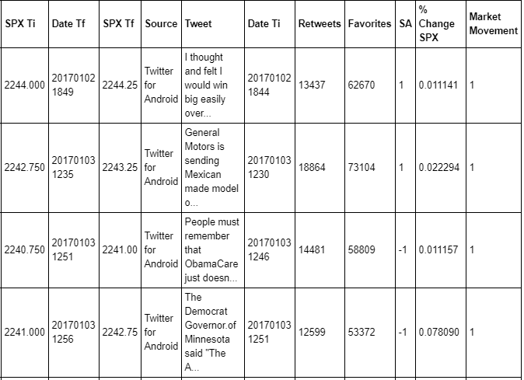
Merged Data
The final data frame combined the Trump’s tweets, sentiment analysis on the tweets, S&P 500 prices, volatility, and market movement direction.

Slide 8
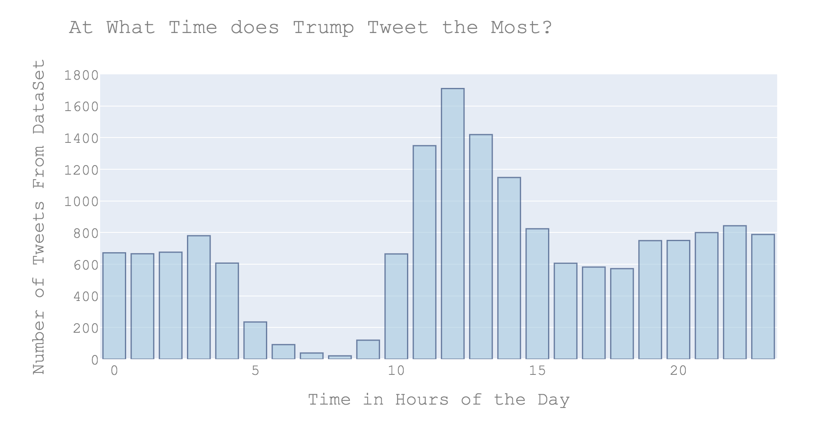
Data exploration

Slide 9
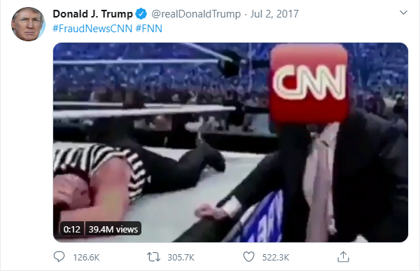
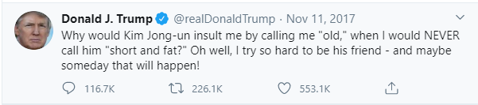
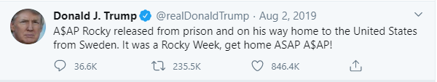
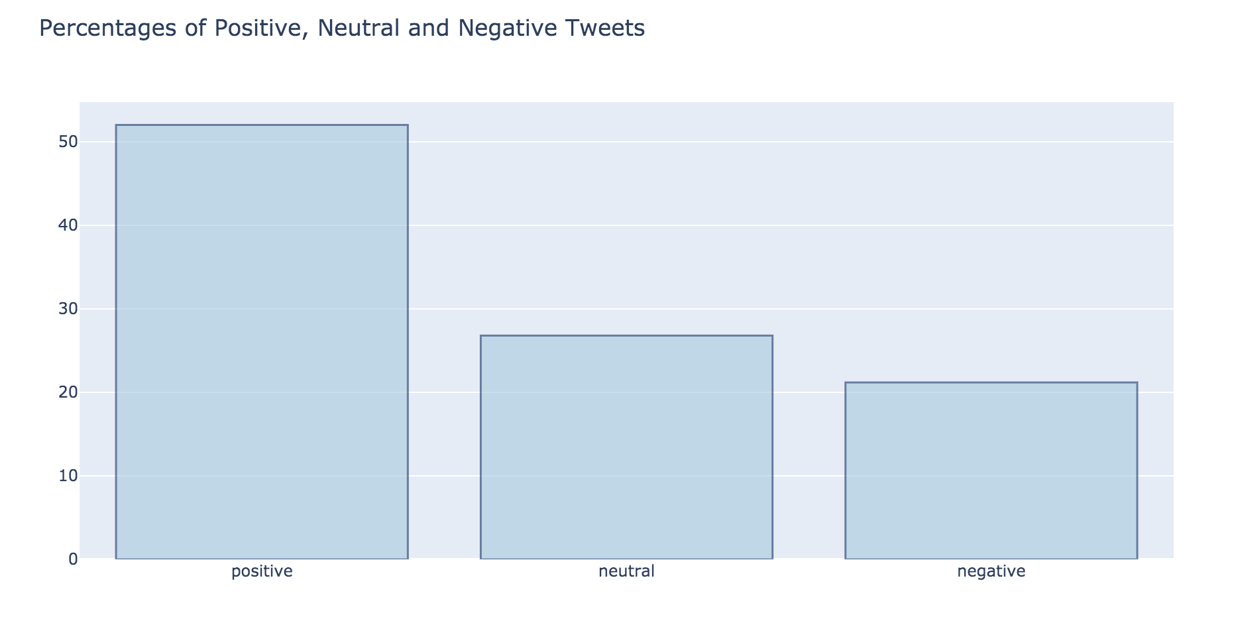
Data exploration
Below are the top 3 most retweeted posts during Trump’s presidency:

Slide 10
model
XX.

Slide 11
conclusion
XX.

Slide 12
Questions?

Slide 13
Thank you!

